Slide 1
J Street Drain Project
Addendum to
Environmental Impact Report
Notes:
Good morning Chairperson Bennett, members of the Board and CEO Powers.
For the record, my name is Tully Clifford. I am the Watershed Protection District Director.
I am joined by:
1) Peter Sheydayi, Deputy Director of the Design and Construction Division
2) Kirk Norman, the design project manager;
3) Angela Bonfiglio Allen, a member of our Environmental Services Staff; and
4) Tim Gnibus of HDR, our environmental consultant.
We’re here today to request approval of design changes to Reaches 2 – 4, as well as approval of the Addendum to the EIR for the J Street Drain project, which evaluates the environmental impacts of these design changes.

Slide 2
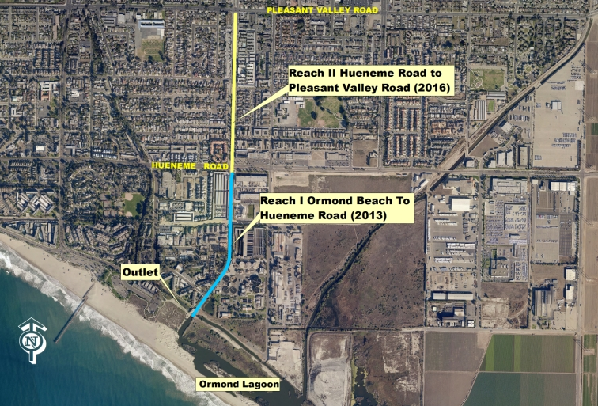
PROJECT REACHES 1 & 2
Notes:
The limits of the project are from Ormond Beach Lagoon to Redwood Street. This map shows roughly the south half of the project. The project is the enlargement of approximately 2.2 miles of existing concrete channel that was constructed in 1961 so that it can convey the 1% annual chance flow event, also known as the 100-year flood.
Each project reach will incrementally provide flood benefits.
Reach 1 = 2,677 LF (stops just short of Hueneme Rd); Reach 2 = 2,623 LF (stops just short of Pleasant Valley Rd)
Dividing the project into four reaches allows the District to minimize environmental impacts in the forms of traffic and air quality from year to year.
Project phasing provides the opportunity to pursue supplemental grant funding for each reach.

Slide 3
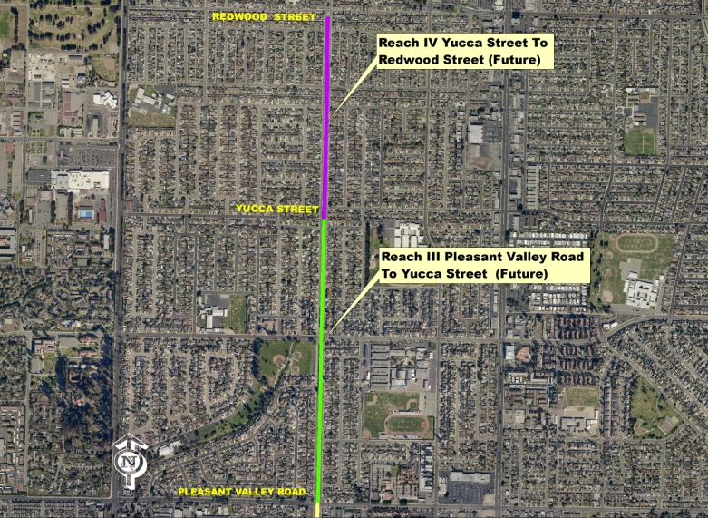
PROJECT REACHES 3 & 4
Notes:
Phases 3 and 4 are not yet scheduled in our 5-year CIP, but are anticipated to be scheduled in future CIP documents, as grant or other supplemental funding is identified.
Reach 3 = 4,102 LF; Reach 4 = 2,855 LF
We know the public is anxious to enjoy recreational opportunities over the entire facility, so we will do our best to make this a reality as soon as possible.

Slide 4
Existing J St Drain EIR
Certified by your Board on March 27, 2012
Requests from private citizens, environmental organizations, and City of Oxnard to select the underground box culvert alternative
  2009 Draft EIR
  2011 Recirculated DEIR
  2012 FEIR Certification Hearing
Board instructed staff to seek supplemental funding for box culvert, and return with a revised CEQA document if successful
Notes:
Environmental Organizations and their comments in support of Alternative A (box culvert design):
Ventura Coastkeeper/Wishtoyo (water quality, specifically trash; public health; Oxnard residents’ well being, community development; economic condition of Oxnard residents; visual and scenic resources)
CAUSE = Central Coast Alliance United for a Sustainable Economy (community unification, pedestrian safety, local/regional recreational opportunity, and water quality, specifically trash)

Slide 5
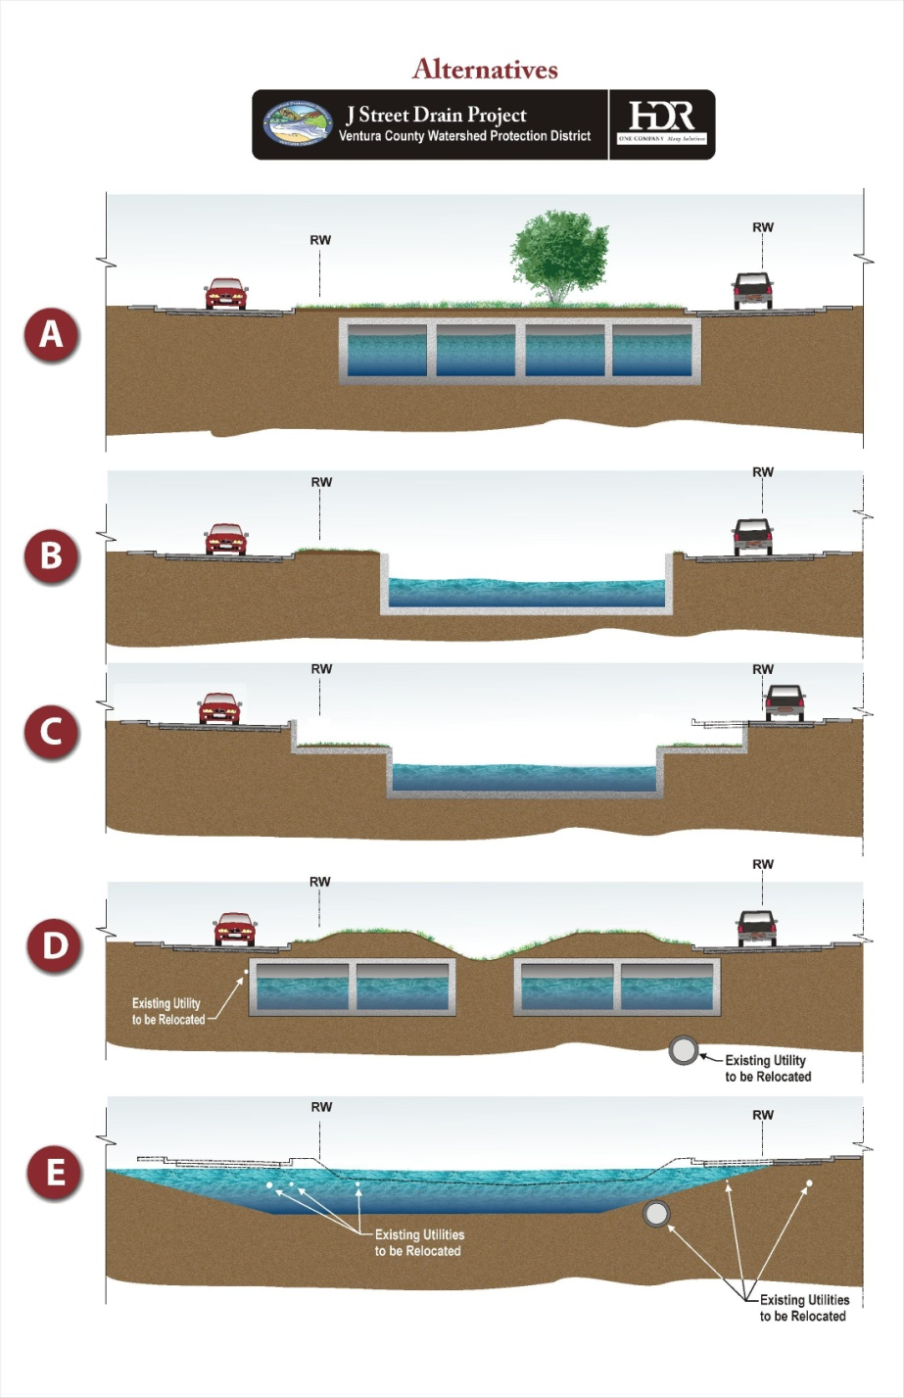
FEIR CHANNEL
ALTERNATIVES*
A – Reinforced Box Culvert
(Addendum to EIR: Preferred Alternative)
  B – Vertical Wall Channel
  (EIR: Preferred Alternative)
C – Low Flow Channel with Overflow Area
D – Dual Reinforced Box Culvert
(not south of Hueneme Road)
E – Natural Channel Section
*Not to Scale
Notes:
These are the 5 channel alternatives discussed in the FEIR for the project. Alternative B was the preferred project alternative. Now it’s Alternative A.
At the 2012 certification hearing, we stated that although Alternative B was preferred, in the future there was some possibility of returning before the Board and requesting selection of Alternative A, the box culverts overlain with a greenway or park. Because this alternative was estimated to be approximately $15 million more expensive, the District and the City of Oxnard agreed to investigate grant funding, or other funding sources. We would have liked to recommend approval of Alternative A at that time, but the funding identified in light of other zone priorities would have made funding this alternative very difficult.
The District committed to prepare an Addendum to the J Street Drain EIR if additional funding for box culverts was identified in the future.

Slide 6
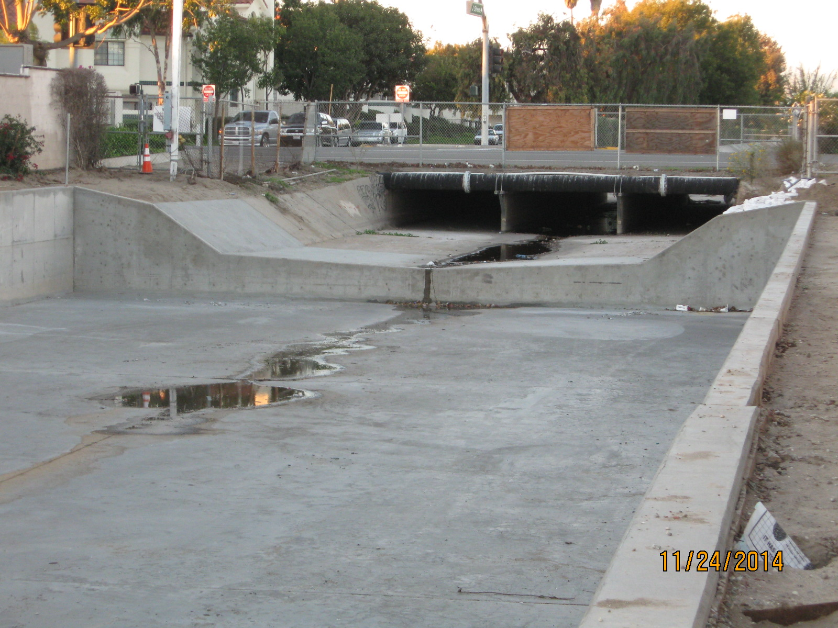
REACH 1 CONSTRUCTION COMPLETION: JANUARY 2015 (UPSTREAM END)
Notes:
Your Board approved the Reach 1 construction contract in July 2013. Construction was completed last week.
You can see from this photo, taken at the upstream project limits, that the original facility is an open, trapezoidal shaped concrete channel. Reach 1, however, was just reconstructed and is now an enlarged rectangular concrete channel.

Slide 7
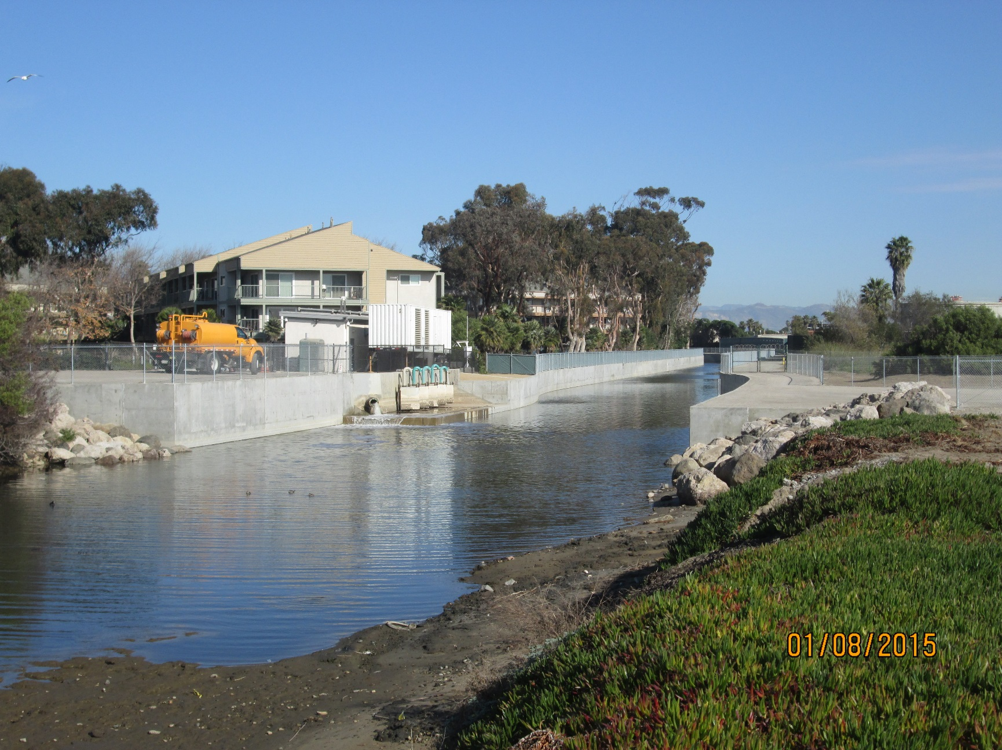
REACH 1 CONSTRUCTION COMPLETION: JANUARY 2015 (DOWNSTREAM END)
Notes:
The channel curves around the Hueneme Drain Pump Station, visible in the left center of the photo. The Surfside III condominium community is behind it, the Oxnard Wastewater Treatment Plant is across the channel in the right center, and the sensitive Ormond Lagoon is in the lower half of the photo.
Please note that due to the presence of the endangered California least tern, which feeds on topsmelt in the drain, and endangered tidewater goby, a tiny fish that lives in the drain downstream of Hueneme Road, the box culvert alternative ends at the recently completed open channel extending from Hueneme Road downstream to the Ormond Lagoon.

Slide 8
SUPPLEMENTAL FUNDING
January 2013: Submitted Proposition 1E Stormwater Flood Management Program Grant Application – No Funding Awarded
April 2013: Submitted Proposition 84 Integrated Regional Water Management Implementation Grant Application (One of 6 Local Projects)
  Awarded $4,419,000 for Reach 2 Reinforced Concrete Box Culvert in February 2014

Slide 9
GRANT PROJECT TASKS/SCHEDULE
Reaches 2 – 4
  CEQA Addendum Approval: January 2015
  Update Existing/Obtain New Permits: June 2015
Reach 2 Only
  50% Project Design: April 2015
  100% Project Design: October 2015
  Advertise Construction Contract: January 2016
  Award Construction Contract: April 2016
  Complete Construction: September 2017
Notes:
A roughly 17-month construction schedule is anticipated for Reach 2.

Slide 10
EXISTING VIEW
HUENEME ROAD AT J STREET
Notes:
This is a view in the upstream direction from the intersection of J St and Hueneme Rd (just upstream of the Reach 1 and 2 boundary). From Hueneme Road to Redwood Street, the channel lies between the two directions of J Street traffic.

Slide 11
POSSIBLE PARK ENTRANCE
HUENEME ROAD AT J STREET

Slide 12
ADDENDUM TO THE
J ST DRAIN EIR
Potentially Significant Impacts are Similar to the EIR and Mitigated Below a Significant Level
Visual Resources
Biological Resources
Water Resources and Hydraulic Hazards
Transportation and Circulation
Noise and Vibration
Geologic and Seismic Hazards
Hazardous Materials
Cultural Resources
Waste Treatment and Disposal
Public Health
Greenhouse Gas Emissions
Notes:
Impacts evaluated in the Addendum are similar to those originally analyzed in the EIR, with no substantial increase in level of significance identified.

Slide 13
MITIGATION REVISION
Visual Resources: Mitigation Measure VIS-1
  Previous: The District shall provide landscaping to replace the oleander bushes removed along J Street Drain between Hueneme Rd. & Redwood St. by agreement with the City of Oxnard. Landscaping shall be replaced incrementally, within 6 months of completion of each project phase.
  New: By agreement with the District, the City of Oxnard shall create & maintain a linear multi-use trail and/or park atop those portions of the J Street Drain that are converted from open channel to buried box culverts. Installation of the linear park shall occur incrementally, and shall begin as funding is identified. A multi-use trail/park design shall be developed within 3 years after finishing construction of each reach. Until the linear park is installed, the City shall be responsible for maintaining its alignment free of weeds, trash, or other deleterious materials.
Notes:
All other mitigation for the conversion from open channel to buried box culverts remains adequate to reduce significant impacts below a significant level, and is therefore the same as originally presented in the EIR.

Slide 14
REQUEST
Approve Changes to Reaches 2 – 4 of the
J Street Drain Project
Approve the EIR Addendum
Authorize WPD Director to Sign and File the Notice of Determination
Authorize WPD Director to Take all Actions Necessary to Carry out the Project
Notes:
Summarizing the recommendations specified in the Board Letter, we request that your Board: See Slide Points.

